Slide 1
Focused Benchmarking Current State to Best in Class
Richard Wiltse
Master Black Belt
Notes:
WELCOME to “DOE: From Hunch to Crunch … I’m Ellen Milnes from MoreSteam.com and will be today’s program moderator.
This program is part of our monthly Master Black Belt Webcast Series sponsored by MoreSteam.com.

Slide 2
About Tremco Commercial Sealants and Waterproofing –
North America's foremost supplier of sealant, weatherproofing, and passive fire control solutions for commercial and residential construction and industrial applications.
Serve products and services to architects, engineers, home builders, contractors and building owners worldwide.
Part of Tremco Inc. held by RPM

Slide 3
About AME Cleveland Lean Consortia
Started in 2014 SGS Tool, Rockwell Automation, Graftech, and Tremco. 2nd wave: Goodyear, SSP, Preformed Line Products, Qualtech. Recently added MTD
Our Vision: The AME Cleveland Lean Consortia Vision is to provide our member companies with a platform for Benchmarking, Learning, Sharing and Growing our collective Lean and CI programs. We will accomplish this through creation of a collaborative learning environment in which Lean Leaders can learn, implement, and share their ideas and discoveries.
Benchmarking, Roundtable discussions, Workshops

Slide 4
Background
Richard Wiltse
Tremco Commercial Sealants & Waterproofing
Master Black Belt developing Lean Six Sigma teams and continuous improvement culture across organizations
Founded the AME Lean Consortia Cleveland chapter
Education:
B.S. – Illinois State University,
MBA – Shenandoah University,
Master Black Belt – Ohio State/MoreSteam.com

Slide 5
Good is
the Enemy of Best
Best is
the Enemy of Better

Slide 6
“We still haven't played Madison Square Garden. That's a benchmark. Something will have gone seriously wrong if we don't play Madison Square Garden for this album.”
Dan Hawkins
English Rock Guitarist

Slide 7
Benchmarking:
The continuous process of searching, identifying, and adapting new ideas for methods, practices, and processes….
The continuous process of measuring our products, services, and practices against the toughest competitors or industry leaders.
The search for Best Practice !

Slide 8
The simple goal of Benchmarking:
“Actionable Intelligence”

Slide 9
Has your company ever performed a formal Benchmarking event?

Slide 10
Presentation agenda
Brief history of Benchmarking
Types of Benchmarking
Benchmarking definitions and lingo
Why Benchmark? Critical success factors
Focused Benchmarking

Slide 11
Brief history of Benchmarking
Pre industrial revolution: craftsman benchmarked each other for better methods
Late 1800’s Fredrick Taylor encouraged comparison of work processes and standardization
WW2: Companies benchmarked each other to help meet production demands as well as standards for pay, safety, etc
1950’s Taiichi Ohno / Shigeo Shingo benchmarked American manufacturing….grocery store replenishment !
1970’s Xerox Corporation performed competitive, process, and functional benchmarking

Slide 12
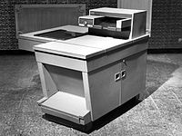
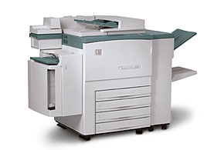
Benchmarking
Prior to the Xerox event, benchmarking was an art
Xerox brought benchmarking to a science

Slide 13
Xerox
Patents ran out in 1975
Foreign competition entered the market with small personal copiers, as opposed to large industrial copiers
Competition experienced a steady gain in market share... Xerox losing business one page at a time!
New products taking twice as long in development
Xerox manufacturing cost equal to sales price of competition
Declining ROA: 25% to 5%

Slide 14
Xerox
Created a team of managers to investigate best practice of other companies
Xerox turned to others …
Sears: inventory management
LL Bean: warehouse operations
American Express : Billing and collection
Toyota: Quality Management
Hewitt Packard : R&D

Slide 15
Xerox Benchmarking results – early 1990’s
Customer Satisfaction up 38%
Customer complaints down 60%
Service response time down 27%
Inventory costs reduced 66%
Increase in sales
Decrease in cost per labor hour
Won Malcom Baldridge award

Slide 16
Types of Benchmarking
Strategic: Long term strategies. Breakthrough opportunities
Competitive / Performance : Products, Competitive product designs
Process: Benchmarking a general process such as Innovation, Six Sigma, or Lean
Functional: Compare functional area such as Purchasing practice
Internal: Within company such as a sister plant
External: Outside the company
Generic: Outside one’s own industry
International: Outside your country

Slide 17
Definitions
Best Practice: The set of activities tasks, resources, training and methods that created the observed level of performance
Process expert validation, otherwise subjective
Entitlement: The best level of accomplishment your current process can achieve – no defects, no hiccups, no delays, etc.
Represents the gap between original process design and current process performance
Baseline Analysis: Initial comparison of performance data across all benchmarked processes.
Highest average sustained performance

Slide 18
Definitions…. cont
Gap analysis: The evaluation of the performance difference between current internal state at entitlement and benchmark performance at best practice
Gap analysis may include confidence intervals
Critical Success Factors: Vital few factors that resulted in Best Practice as measured by quantifiable indicators of process performance and capability in key business processes
Effectiveness, efficiency, economy
Quality, cycle time, cost
Enabler: The specific activity, method, action, or technique that stimulated progress in one process over comparative processes that lead to identification of best practice
Example: Using FMEA in product development

Slide 19
Why Benchmark?
What does “Best” look like ?
How does your current practice stack up?
Set realistic goals…allowing for better estimates of resource allocation
Motivational value
“Management likelihood value” Easier when others go first
Awareness of hurdles, pains, and enablers required to make a breakthrough
Challenges the status quo
Breaks down the “not invented here” syndrome

Slide 20
Success factors
An active commitment from Management
Willingness to change and adapt
Know your own process as the baseline for comparison
Ability to understand and articulate the gap
Use of creativity and innovation on observations made
Realization that the competition is likely changing to get better
Willingness to share information
Relationships with associates in leading companies
Continuous benchmarking and commitment to learning!!!
Adherence to a benchmarking process
Documentation

Slide 21
“Focused” Benchmarking
Benchmark topic is driven by the needs of the organization and determined semi-annually at board meetings.
Focused on particular Lean topics – Example: Product Innovation, Lean Office, Toyota Kata / Coaching, TPM
Pre-Benchmark survey
Research on Best Practice
Pre-Benchmark visit
Interviews, Go and see, Facilitation strategy
Benchmark event
Participative, facilitated
Post Benchmark Report

Slide 22
Pre-Benchmark Survey – TPM
Survey questions reviewed by numerous experts:
Consortia facilitators
Consultants
Local experts
Book authors
Piloted
Distributed one week in advance
“What does Best Practice look like ???”

Slide 23
Total Productive Maintenance
Thursday, November 05, 2015

Slide 24
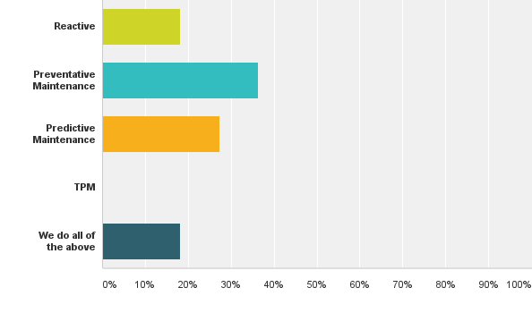
Q1: Describe your companies maintenance program.
Answered: 11 Skipped: 0

Slide 25
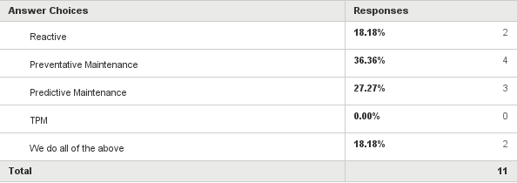
Q1: Describe your companies maintenance program.
Answered: 11 Skipped: 0

Slide 26
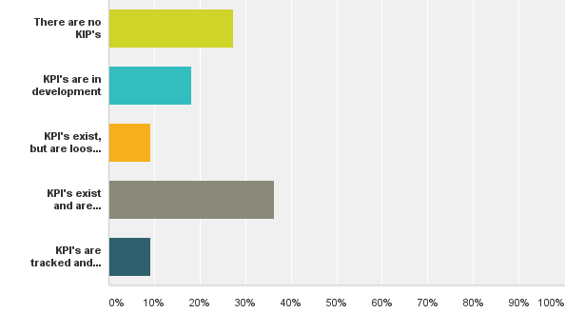
Q5: Do key performance indicators (KPI's) exist for maintenance and are the KPI's being monitored?
Answered: 11 Skipped: 0

Slide 27
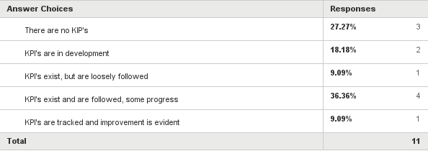
Q5: Do key performance indicators (KPI's) exist for maintenance and are the KPI's being monitored?
Answered: 11 Skipped: 0

Slide 28
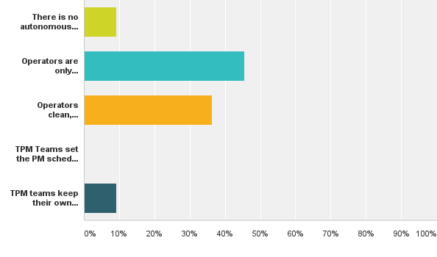
Q11: Is there an autonomous maintenance program?
Answered: 11 Skipped: 0

Slide 29
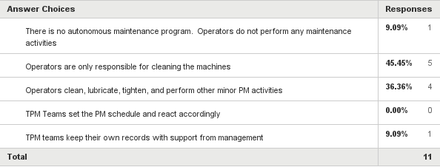
Q11: Is there an autonomous maintenance program?
Answered: 11 Skipped: 0

Slide 30
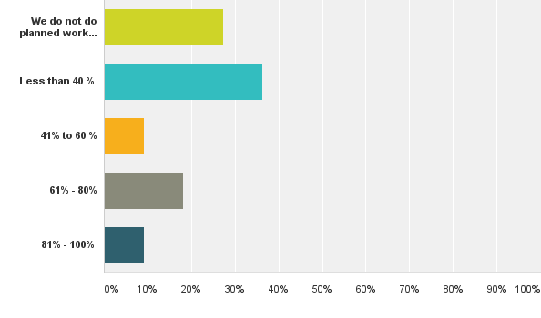
Q17: What percentage of work orders are planned vs reactive?
Answered: 11 Skipped: 0

Slide 31
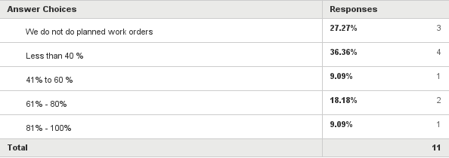
Q17: What percentage of work orders are planned vs reactive?
Answered: 11 Skipped: 0

Slide 32
Benchmarking Survey
Allows the organization a preliminary understanding of what Best Practice looks like
The organization sees where they rank relative to other Consortia members as well as Best Practice – Quantifiable Gap Analysis !
Participants in the Benchmarking Study are “prepped” for the event
Eliminates “Industrial Tourism”
Identifies key Benchmarking companies for future reference
Survey outside the Consortia

Slide 33
Pre-Benchmark visit
What are the strengths?
What are the weaknesses?
Encourage being humble !!
Go to the Gemba
Develop Facilitation / Learning strategy
Prep the host company
How can I make this a learning experience?

Slide 34
Benchmarking event
Standard work
Gives the host company a template to work to
Events are more efficient and informative
Hones in on key deliverables
Provides a baseline for benchmarking improvement

Slide 37
Benchmark Facilitator Report
Summarizes key learnings and focus features
Archives the event
Primary use as a “memory jogger”
Can be used as evidence in a change effort
Report
Executive summary
Agenda
Key points with lots of pictures
Consortia members review

Slide 42
Facilitator Report – Consortia Member Review

Slide 43
Summary
Focused Benchmarking
Use of surveys to provides a complete and quantifiable baseline used for gap analysis
Pre-Benchmark visit to develop facilitation strategy
Follows a comprehensive standard process which includes facilitated discussions and feedback to the host company
Archived Reports

Slide 44
Challenges and Lessons Learned
Survey concept
Nationwide surveys in development
Surveys to include summarized score
Best practice
Go outside the Consortia
Standard Work needs to be improved
Template to use in each Benchmarking session
Kill Industrial tourism

Slide 45
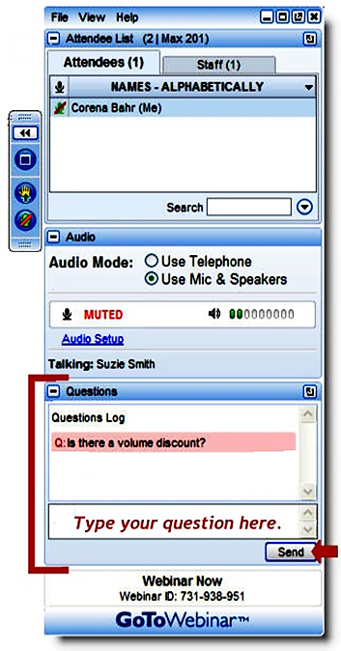
Questions
Richard Wiltse
Tremco Inc., MBB
How have you handled ....
Have you ever encountered ....
Would you explain more how you’ve approached ….
Notes:
45
Thank you, Richard.
We’ll spend the final portion of our program today responding to questions from attendees.
If you haven’t already submitted a question, please remember to type your question in the Attendee Control Panel.

