Slide 1



DOE: From Hunch to Crunch
A Tremco Case Study
Richard Wiltse
Tremco Inc.
Master Black Belt
Sponsored by:
Notes:
WELCOME to “DOE: From Hunch to Crunch … I’m Ellen Milnes from MoreSteam.com and will be today’s program moderator.
This program is part of our monthly Master Black Belt Webcast Series sponsored by MoreSteam.com.

Slide 2
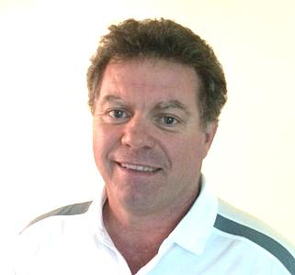

Today’s Presenter
Richard Wiltse
Tremco Commercial Sealants & Waterproofing
Divisional Black Belt developing Lean Six Sigma teams and continuous improvement culture across organization
Founded the AME Lean Consortia Cleveland chapter
B.S. – Illinois State University, MBA – Shenandoah University, Master Black Belt – Ohio State/MoreSteam.com
2
Notes:
Richard is a Divisional Black Belt for Tremco Incorporated, a leading manufacturer of Sealants and Waterproofing technologies. During his tenure at Tremco, Richard has been instrumental in developing Lean Six Sigma teams and sustainment systems that have accounted for a 27% improvement in productivity and over $500,000 in hard savings in a multi-facility environment.
Richard further developed the Continuous Improvement spirit across all levels of the Tremco organization, and subsequently introduced the “small k” process for idea generation. To date, this process has accounted for over 1,000 small ideas that have further increased productivity and spawned numerous Lean Six Sigma teams. Richard has also promoted Lean in the broader community by starting the Cleveland AME Lean Consortia.
Richard recently received his Master Black Belt certification from Ohio State – MoreSteam. He holds an MBA from Shenandoah University and a BS from Illinois State University.

Slide 3
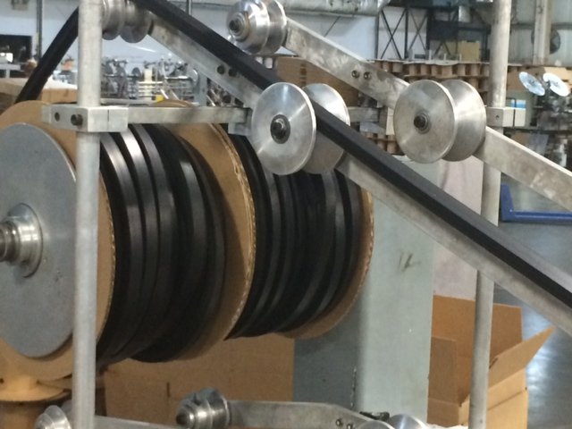
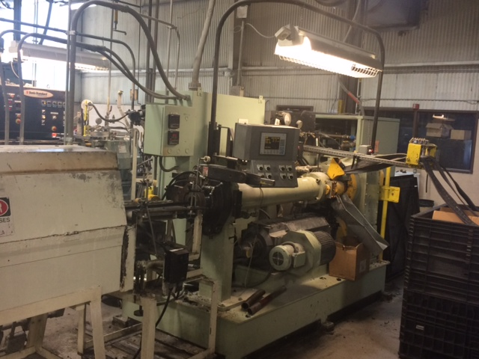
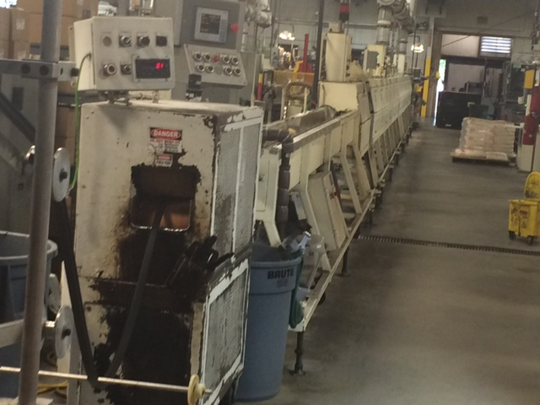
A Tremco Case Study: Silicone Viscosity
DOE: Effect of processing and time on silicone viscosity

Slide 4
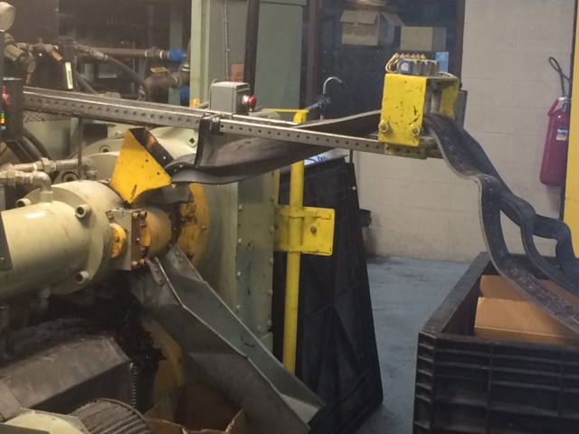
Background information
Silicone rubber is produced in small, 175 lb batches that cycle approximately every 15 – 20 minutes
“Small adds” of various raw’s are weighed and sent to a mixer for a 15 minute mix time
The mixed material is then sent to a mill where it is milled for several minutes
The milled material is sent to an extruder and extruded into strips, then placed in a tote for shipment
Various Quality checks are performed on each batch, including viscosity
Shelf life

Slide 5
Tremco Case Study: DOE Silicone
Effect of processing and time on silicone viscosity: AGENDA
Hunch and clues that a DOE may be needed
  How to spot when a DOE may be the best approach
What are we out to achieve?
  Problem definition and supportive data, DMAIC
Critical Success Factors (CSF’s)
  What can make or break your experiment! Culmination of experience
Additional DOE Benefits
  Getting the most from your experiment
Analyze the Experiments!

Slide 6
Clues that a DOE may be needed
There exists a quality issue that comes and goes….
Everyone has a reason why the issue occurs….yet the quality problem persists
There exists little or no supporting data…only opinions and perceived observations
No one – including Engineers, Operators, and Front Line Personnel, can precisely define process specifications

Slide 7
Define: What are we out to achieve?

Slide 8
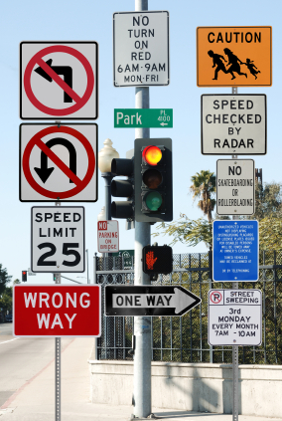
CSF # 1: Agreed upon charter
Reduces scope expansion
Eliminates confusion over problem severity
Properly directs Team forward

Slide 9
Measure - Historical baseline
MEASURE
Gathered data from Supplier Certs
Evidence of both trending and stratification

Slide 10
CSF#2: Do your homework on baseline data
Demonstrates a need
  Our data clearly shows excess variability that is detrimental to manufacturing
Allows the ability to quantify an improvement
  “If you don’t know where you are, how will you get to where you are going?”

Slide 11
Measure - Gage R&R

Slide 12
CSF#3: Insist on Measurement Standard Work
Document, document, document
  Procedural drift
Will take several trials to ensure complete understanding

Slide 13
Analyze
What is the true shelf life of Silicone Rubber?
What viscosity levels should we trial at (in extrusion) in order to start specification development?
What are potential processing factors (at our supplier) that influence viscosity?

Slide 14
Analyze: Time Series Trend Analysis, 10 weeks
Silicone changes in viscosity over time.
How much depends on starting point. Regression coefficients:
ML Coefficient
1.5 .055
2.0 .076
2.5 .164
Extrusions ran well at the 2.0 + - .3 range

Slide 15
DOE benefit – specification analysis
DOE’s (Factorial or OFAT) provide samples that properly defines specifications
  Data based specifications, as opposed to “Industry Standards”
  Samples for both setting and confirming specs

Slide 16
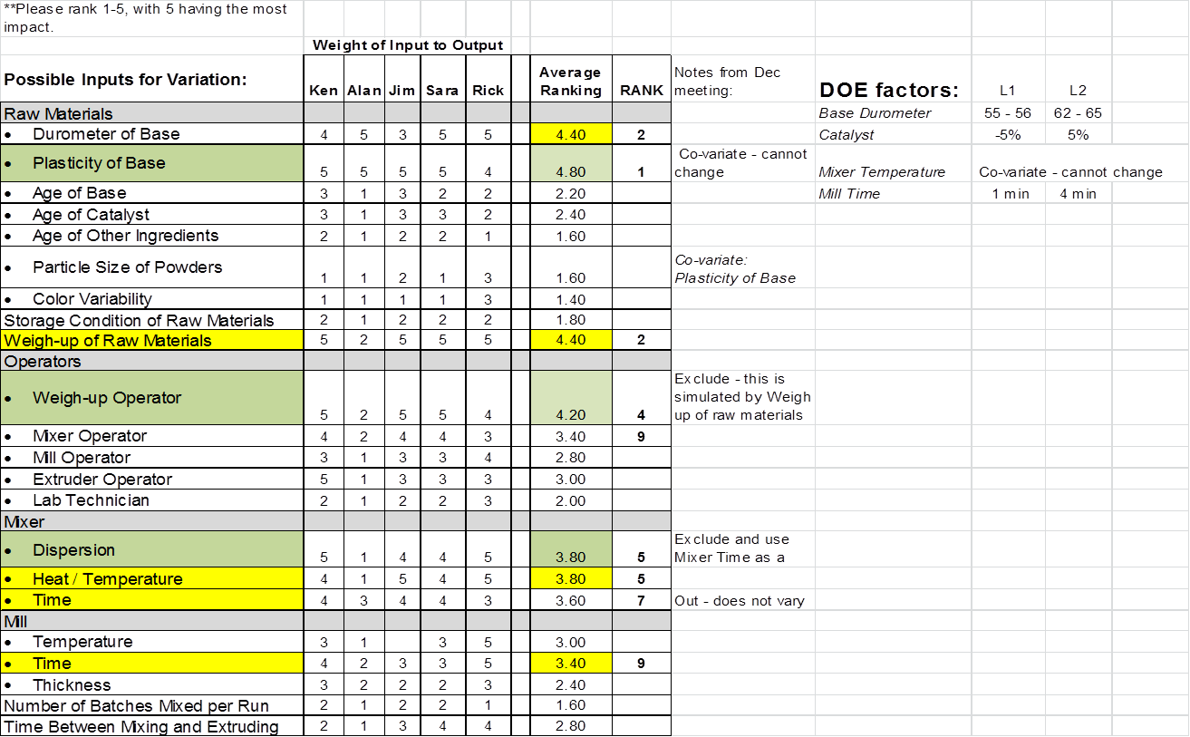
Analyze: Factorial DOE - Brainstorming

Slide 17
CSF#4: Facilitated Brainstorming
Use a skilled facilitator that is neutral..i.e…no bias
Involve the right people
Use “Round Robin” to ensure everyone has an equal chance of contributing
Multi vote potential factors

Slide 18
Improve: DOE
Factor Low High
A Base Durometer 55 63
B Catalyst -0.05 0.05
C Mill time 1 4
Covariate: Temp of material
Response: ML viscosity Replicates: 4

Slide 19
CSF#5: Factor Level Settings
Study what the historical factors ran at – review set up sheets
  Many Operators have their own set up sheets
For initial screening experiments like this, Level 1 and Level 2 should be set at the extremes of normal processing parameter values
  Associates unfamiliar with DOE will tend to over inflate parameter values

Slide 20
CSF#6: Strive for adequate power through additional replicates
Associates unfamiliar with DOE often do not see the need for replicates and randomization
  Power: “the likelihood you will find a significant effect when one truly exists”
  “You get what you pay for”
  Committing resources, time, and material … jump in with both feet

Slide 21
Monitoring the DOE
Recommend to have at least two people monitoring the experiment
  Are factor levels correct?
  Has the process levelled out since the last change?
  Are we randomized?
  Are measurements of the Quality Characteristic being performed correctly?
Check and double check each other

Slide 22
CSF #7: Have a Plan for Monitoring
There are a million ways your DOE can go wrong….
  False signals
There is only one way for the DOE to go right
  Have a Plan !!!!!
      Review randomization and overall design
      Who will be monitors
      Sample identification
      Sample placement and measurement

Slide 23
Review
DOE Critical Success Factors:
  CSF #1 Proper charter
  CSF #2: Good historical baseline
  CSF #3: Adequate Gage R&R w/ Std Work
  CSF #4: Facilitated Brainstorming
  CSF #5: Correct Factor Levels
  CSF #6: Adequate Power
  CSF #7: Proper monitoring
DOE Additional benefit(s)
  Sample based specifications

Slide 24
ANOVA
Factorial Regression: Results versus Temp of mate, base duromet, Catalyst, ...
Analysis of Variance
Source DF Adj SS Adj MS F-Value P-Value
Model 8 0.587247 0.073406 10.43 0.000
Covariates 1 0.006659 0.006659 0.95 0.341
Temp of material 1 0.006659 0.006659 0.95 0.341
Linear 3 0.324007 0.108002 15.35 0.000
base durometer 1 0.319617 0.319617 45.42 0.000
Catalyst 1 0.002421 0.002421 0.34 0.563
mill time 1 0.004114 0.004114 0.58 0.452
2-Way Interactions 3 0.010969 0.003656 0.52 0.673
base durometer*Catalyst 1 0.009194 0.009194 1.31 0.265
base durometer*mill time 1 0.001265 0.001265 0.18 0.676
Catalyst*mill time 1 0.000822 0.000822 0.12 0.736
3-Way Interactions 1 0.001418 0.001418 0.20 0.658
base durometer*Catalyst*mill time 1 0.001418 0.001418 0.20 0.658
Error 23 0.161841 0.007037
Lack-of-Fit 21 0.139741 0.006654 0.60 0.786
Pure Error 2 0.022100 0.011050
Total 31 0.749088

Slide 25
ANOVA – Reduced Model
Analysis of Variance
Source DF Adj SS Adj MS F-Value P-Value
Model 3 0.572212 0.190737 30.19 0.000
Linear 2 0.557762 0.278881 44.15 0.000
base durometer 1 0.556512 0.556512 88.10 0.000
Catalyst 1 0.001250 0.001250 0.20 0.660
2-Way Interactions 1 0.014450 0.014450 2.29 0.142
base durometer*Catalyst 1 0.014450 0.014450 2.29 0.142
Error 28 0.176875 0.006317
Lack-of-Fit 4 0.008375 0.002094 0.30 0.876
Pure Error 24 0.168500 0.007021
Total 31 0.749088
Model Summary
S R-sq R-sq(adj) R-sq(pred)
0.0794793 76.39% 73.86% 69.16%

Slide 26
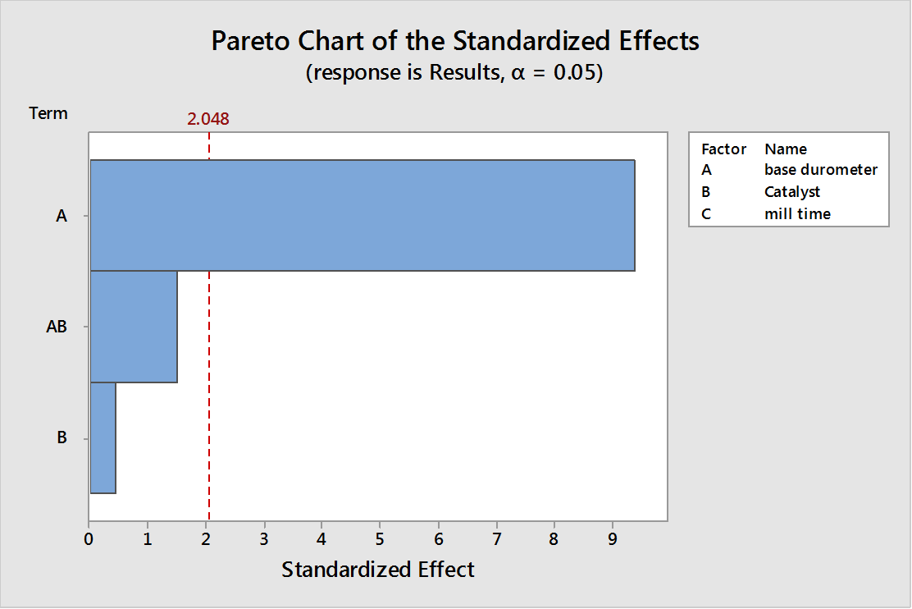
Analyze: DOE Results

Slide 27
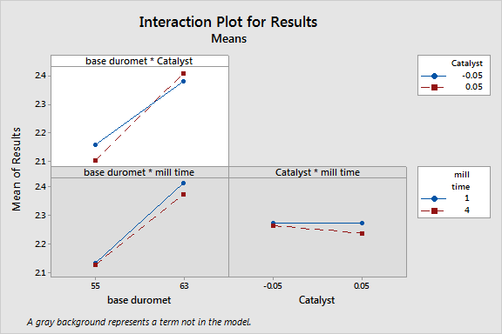
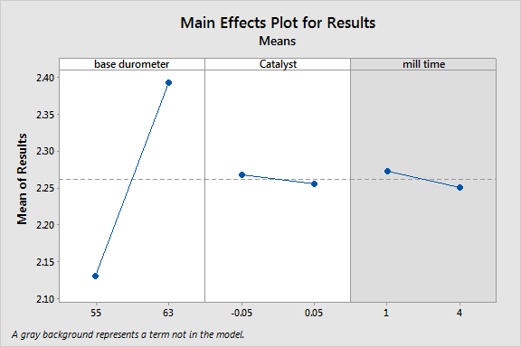
Interaction / Main Effect

Slide 28
CSF #8: Look at the Data…..

Slide 29
….And review the Residuals

Slide 30
Variance Inflation Factor: Are predictors correlated?
Model Summary
Term VIF
Constant
Temp of material 2.31
base durometer 2.18
Catalyst 1.03
mill time 1.00
base durometer*Catalyst 1.07
base durometer*mill time 1.01
Catalyst*mill time 1.02
base durometer*Catalyst*mill time 1.01

Slide 31
VIF

Slide 32
DOE: Analyze Variability
Full factorial
One replicate
Used additional replicates as repeats

Slide 33
Replicates as Repeats ???
Replicates “look like” repeats
Very minimal set up
  Added / deleted Mill Time with a timer
  No tear down
  Raws were all added the same
  Mix was the same

Slide 34
Analyze: DOE Variability
Mill time and the 3 way interaction appears to have influenced batch to batch variability
Sparsity of Effects
Mill time significant at .10 level

Slide 35
Improve: DOE optimal parameters
Optimal parameter settings occurred at:
Base Durometer 55
Catalyst .05
Mill Time 4 min
DOE samples were used to confirm specifications

Slide 36
Improve: Supplier Commitments
Run to specification 2.0 +- .3
Mix Base durometers to achieve target value of 2.0 ML
Increase Mill time to reduce within lot variance (more analysis forthcoming)
Investigate larger mixer batch sizes to reduce both within batch and batch to batch variation

Slide 37
Control: Supplier SPC
Cpk and Ppk values for each lot of material
SPC Individual Moving Range Charts

Slide 38
Lessons Learned
Joint DOE efforts with Suppliers are achievable and can result in win-win
Using replicates instead of repeats to analyze variability, along with only 4 readings, is risky and should only be used where minimal set ups are occurring. Confirm !!!

Slide 39
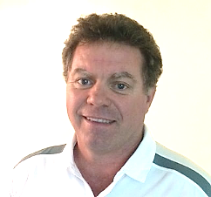
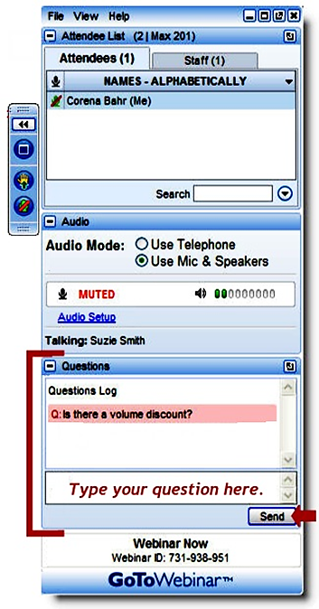
Questions
Richard Wiltse
Tremco Inc., MBB
How have you handled ....
Have you ever encountered ....
Would you explain more how you’ve approached ….
Notes:
39
Thank you, Richard.
We’ll spend the final portion of our program today responding to questions from attendees.
If you haven’t already submitted a question, please remember to type your question in the Attendee Control Panel.

