Slide 1
The importance of
Measurement Systems Analysis
Presented by Lisa Goch
DFSS Project Lead
Diebold, Incorporated
April 2014
Notes:
Good Evening. I hope everyone enjoyed their dinner.
My name is Lisa Goch and I’m a Statistician whose applied statistical techniques to industry for over 20 years.
For the past 5 years, I’ve worked at Diebold in product reliability.
Diebold is known for their durable, high quality ATMs. I’m sure most of you have withdrawn money at a bank ATM.
Ensuring you get the right amount of $ you ask for relies on measuring pieces, parts & systems.

Slide 2
When can tight specifications NOT lead to a quality product?
1
2
3
Specs aren’t set based on Functionality Requirements
Measurement Systems aren’t Calibrated
MSA’s aren’t Conducted
Let’s focus on #3 which is often ignored
Notes:
One needs specifications to have something to measure all those pieces, parts & systems against.
Just setting tight specifications may not lead to quality products.
Specs need to be set based on the functional requirements. Set specs too tight and you’ll be needlessly spending a lot more $ & profitability goes down. Set specs too loose and you won’t have a quality product – customers will be unhappy & you won’t be in business very long. The good thing is, companies do realize the importance of properly set specs.
Companies also realize that measurement systems need to be calibrated. Un-calibrated gages may not provide the correct values. Most companies do have calibration programs in place to ensure their gages are measuring accurately. However, accurate does NOT necessarily mean consistent.
What most companies are lacking is an MSA (also known as a Gage R&R) program for their gages. MSA’s are often ignored or are an unknown entity.

Slide 3
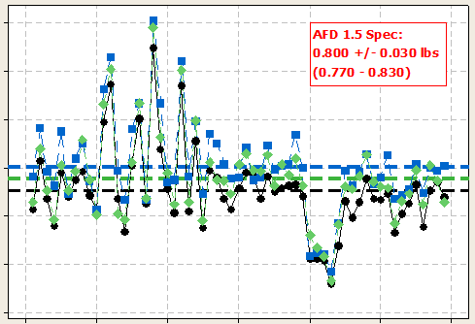

MSA Results on Three CALIBRATED TESTERS:
Force (lbs)
Measured High
In the Middle
Measured Low
Part Number
Notes:
Let’s take a look at a real-life example.
In an ATM, picking forces need to be set properly for 1 note at a time to be picked & correctly counted out for the customer.
These testers measure those forces.
When we measured the same 60 parts on each of 3 testers, we got a surprise. 1 tester read high on most parts, 1 tester read low on most parts & the other tester was in the middle. NOTE: the load cells on all 3 testers were properly calibrated to a very tight specification. There was something else going on here. One of the testers moving parts wasn’t controlled well enough which made the testers measure differently. The only way this problem was caught was by conducting an MSA which not only was used to catch the problem, but subsequent MSAs were used to identify the root cause of the problem. This is the power of MSAs

Slide 4
What is an MSA?
3
MSA’s aren’t Conducted
Measurement Systems Analysis
Notes:
So what is an MSA or Gage R&R Study …

Slide 5
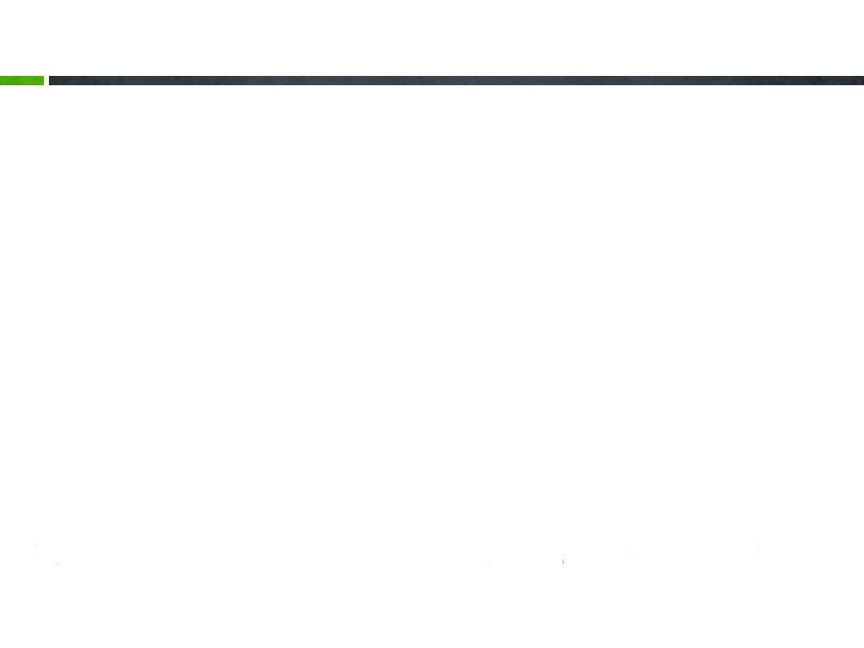
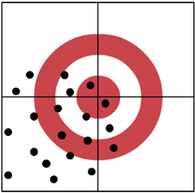
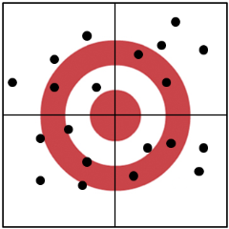
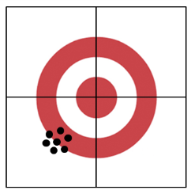
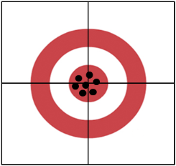
Measurement Components:
CALIBRATED
No
Yes
Bad
MSA
Good

Slide 6

Where does Variation Come From?
Divide and conquer Variation by organizing your Search into the different components.
Overall Variation
Main MSA Components
Measurement System Variation
Part-to-Part Variation
Repeatability
- Gage Error
Reproducibility
Operator
Day
Tester
Procedure
Etc…
Determining the reproducibility factors takes the most time & effort.

Slide 7

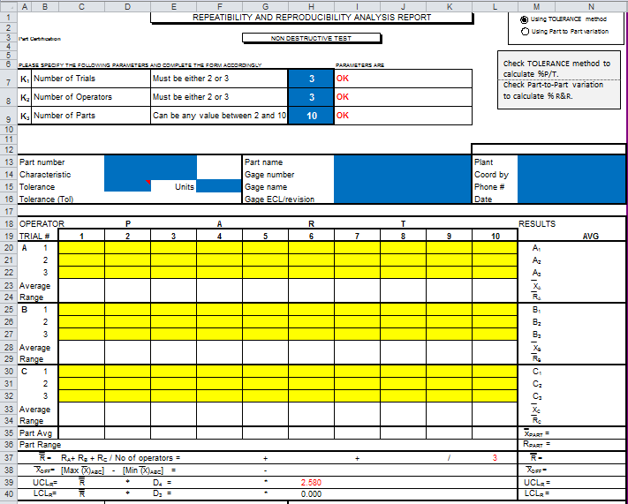
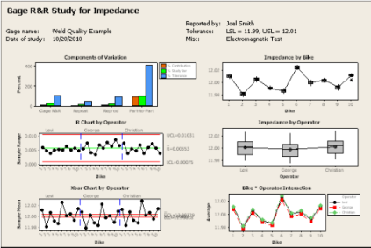
MSA Software:
Excel & Minitab are the 2 most popular for MSA Analysis.
Whatever program is used, a good MSA analysis is about using both Graphs & Summary Metrics to draw conclusions.
Notes:
Excel Template location:
http://www.google.com/url?sa=t&rct=j&q=&esrc=s&source=web&cd=1&cad=rja&uact=8&ved=0CDcQFjAA&url=http%3A%2F%2Fwww.dfx.nl%2Fuserfiles%2Ffile%2Fxls%2FDMAIC%2520-%2520GRR%2520Template.xlsx&ei=z2NIU_rtH6TN2AXTzYDgCA&usg=AFQjCNHzkMbq_pH5Yud1Zr_US4g-8JZp5A&bvm=bv.64542518,d.b2I

Slide 8


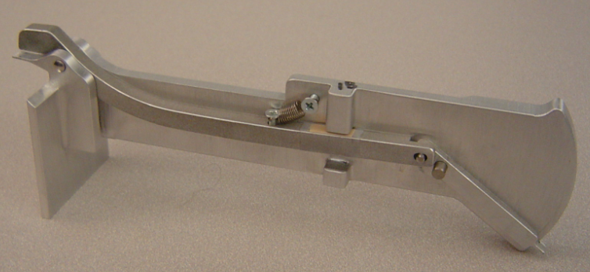
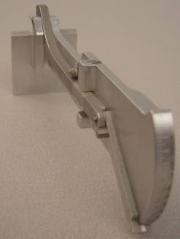
Spacing Gage
How good is this new Measurement Gage?

Slide 9


Standard MSA Procedure
10 Parts – Select Parts from the top, middle & bottom end of the specification
3 Operators – Select different skill levels of operators if possible
3 Repeats – less than 3 may cause problems with mathematical accuracy
Step 1) All Parts are Measured once by all Operators.
    Parts are measured in Random Order
Step 2) Repeat step 1) two more times.

Slide 10

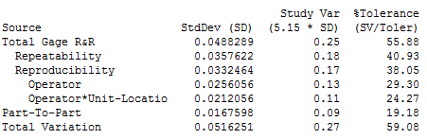
Minitab MSA Analysis: By Operator
% P/T Needs to be <30%
Meas Error: +/- 0.125

Slide 11
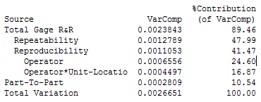
Minitab MSA Analysis: By Operator
Provides Clues for Improvement
Want >80%

Slide 12
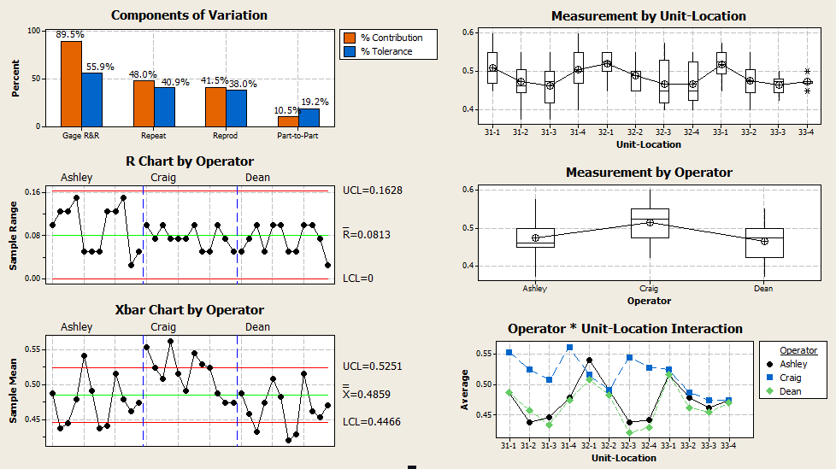
Minitab MSA Analysis: By Operator

Slide 13

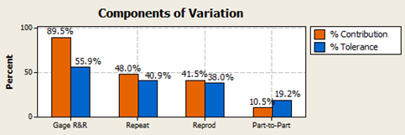
Variance Components Analysis CHART:
% Contribution
  Repeat + Reprod = Gage R&R
  Gage R&R + Part-to-Part = 100%
  Highest % should be Part-to-Part
% Tolerance = % P/T
  %P/T Goal is < 30%
  % P/T is not additive

Slide 14
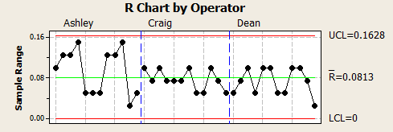
Range Control Chart:
Is there at least 5 different values on the R Chart?
All values should be within the control limits.
Does one Operator have higher values than the others (i.e. more measurement error)?

Slide 15
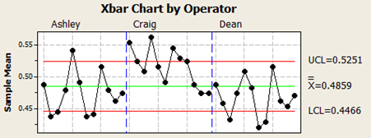
Xbar Control Chart:
Most values should be outside control limits. Points outside says that the gage can discriminate be/t different parts.
Does one Operator have higher values than the others (i.e. on average are the Operators measuring the same)?

Slide 16
Box Plot by Part:
Each part was measured 9 times in the same place.
  Do some parts have a wider spread (more meas error)?
  Does the parts with the largest average have the largest spread? Or vise versa
  Are there any patterns?

Slide 17
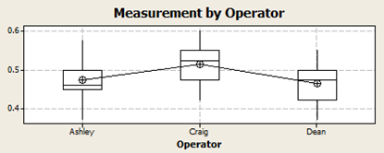
Box Plot by Operator:
Each Operator took 72 measurements (9 Readings * 12 Parts)
  Is any Operator measuring consistently higher or lower than other Operators?
  Does any Operator have a wider spread on their Box & Whisker Plot?

Slide 18
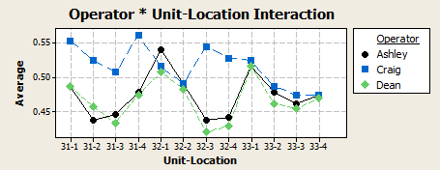
Operator by Part CHART:
Do all Operators get the same Average value on all Parts?

Slide 19
My Favorite Charts
Why does Ashley have more Measurement Error?
Why is she less consistent when measuring the parts?
Why is Craig getting higher Measurements on 6 of the 12 parts?
Is there something different about the parts that he is sensitive too?

Slide 20

When a NIST or other Calibration Standard isn’t available
A place for “Golden” Parts.

Slide 21
Golden Part Selection
“Golden” Parts are often used when a traceable Calibration standard is unavailable.
  A custom Part made precisely to nominal values
  Part(s) specifically selected for their measurement values

Slide 22
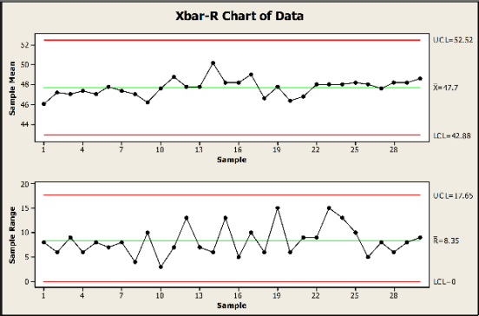
Golden Part Characterization
How “Golden” is your Part?
Does the part measure the same day after day?
Will the part be able to detect drifting or shifts in your measurement system?

Slide 23
To achieve Reliable & Repeatable Part Measurements ➔
1
2
3
Set Specs based on Functionality Requirements
Calibrate Measurement System
Conduct MSA Analysis
Focus must be on all 3 steps!!!

Slide 24





Questions / Comments?
What’s Your Message?

