Slide 1
DOE FOR THE CUSTOMER
Chris Vandegrift
V.P. of Engineering
Selas Heat Technology

Slide 2
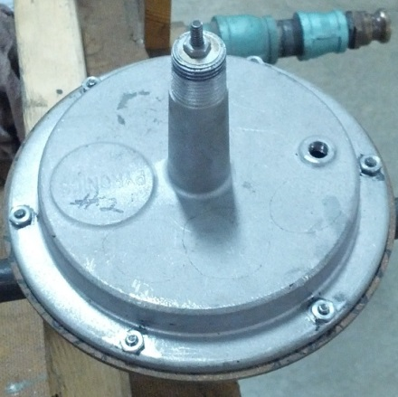
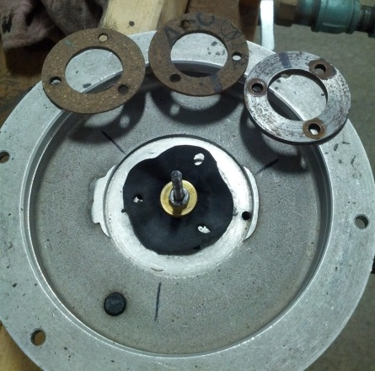
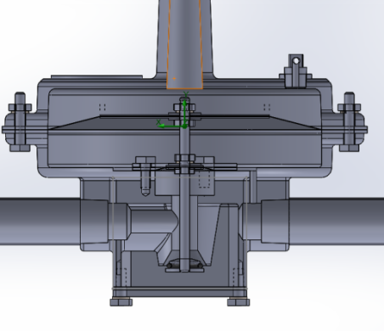
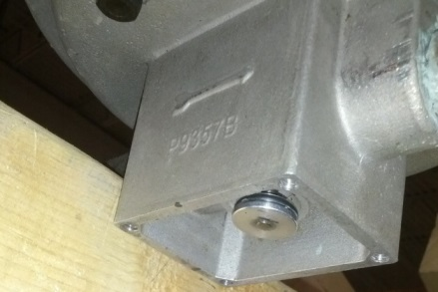
4BZR Regulator
Objective:
Launch the 4BZR – ½” regulator
Conduct performance tests with various conditions: flow rate, pressure variation, washer weights, spring properties and diaphragms.
Meet or exceed the current standard for constant pressure output from the regulator

Slide 3
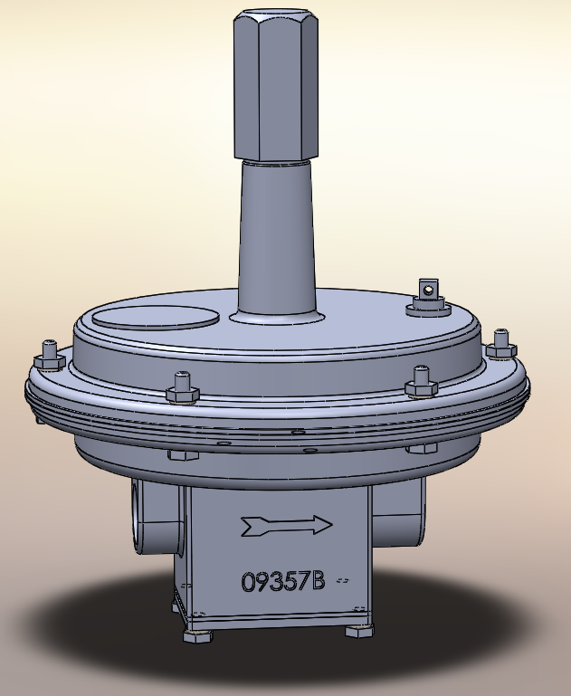
4BZR Before Summer 2013
½” Balanced Zero Regulator
Erratic performance on shut-off
Notes:
Best we could do with current setup. out of 20 test showed failure.

Slide 4
“On-Target with minimum variance.”
“Operating with minimum variance is achieved only when a process displays a reasonable degree of statistical control.”
-Walter A. Shewhart
Variation

Slide 5
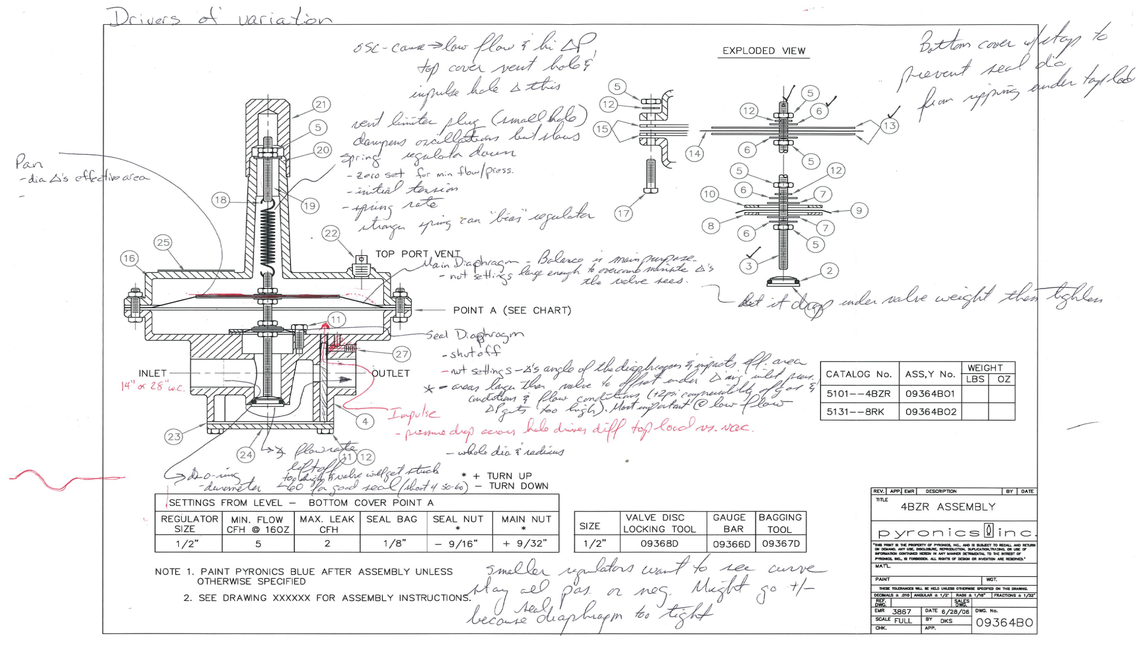
Virtual Fishbone

Slide 6
Design of Experiments (DOE)
Design of experiments is a branch of applied statistics that deals with…
  Planning
  Conducting
  Analyzing
  Interpreting
…controlled tests to evaluate the factors that impact the output of the regulator.
Notes:
Changing one factor a time is the typical method that we all use to determine which factors have an influence and the intensity of the influence on the output. Sometimes the factors being changed have interactions with one another and DOE will help reveal this. Further, Minitab will generate a mathematical model that can be used to simply choose the desired output and minitab will spit out how the factors should be adjusted to reflect this.

Slide 7
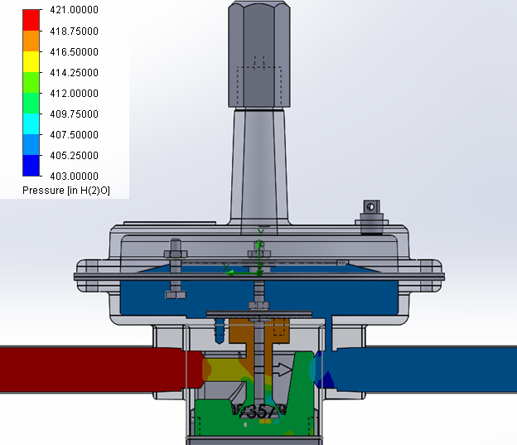
4BZR DOE – Main Effects
Main Nut Setting
Seal Nut Setting
Seal Washer
Diameter
Notes:
At the end of the DOE, with all other factors fixed or removed due to lack of influence on the outlet pressure, the three remaining main effects were revealed and used in the mathematical model.

Slide 8
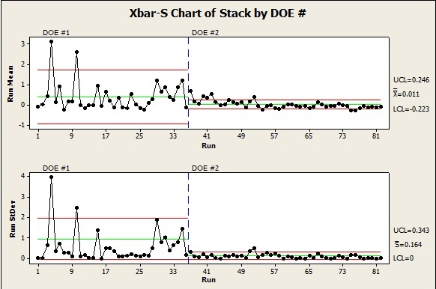
4BZR After DOE

Slide 9
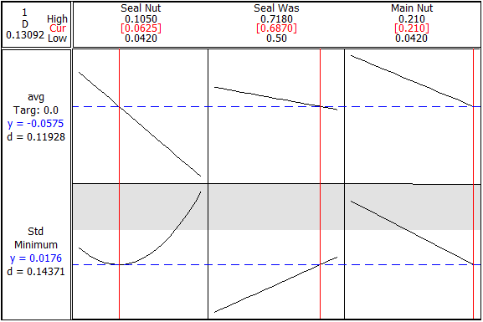
4BZR Response Optimizer
Optimal Settings

Slide 10
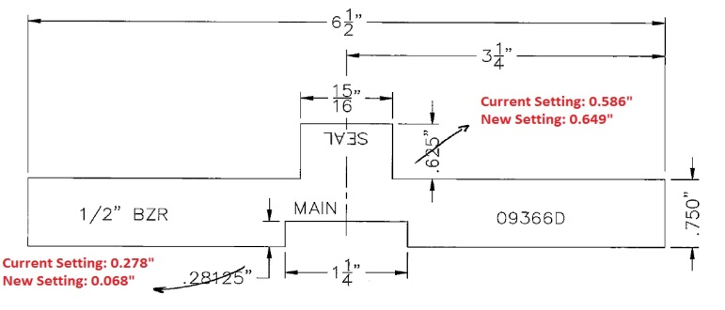
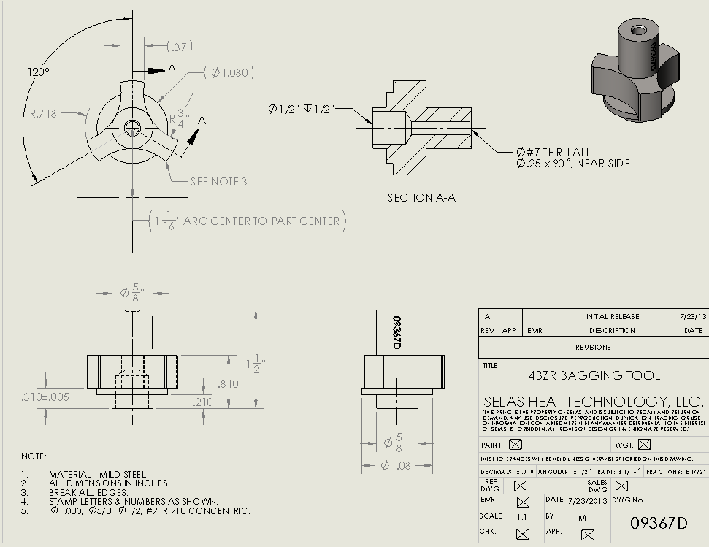
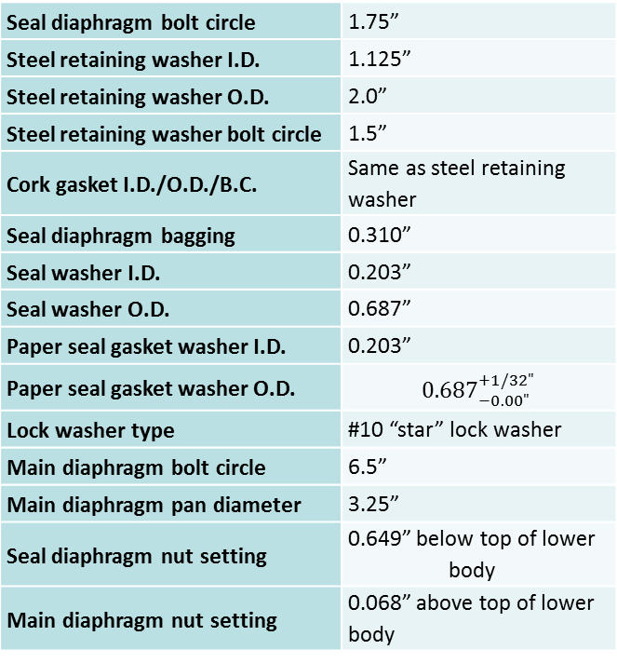
4BZR Component Recommendation
Seal diaphragm bolt circle | 1.75”
Steel retaining washer I.D. | 1.125”
Steel retaining washer O.D. | 2.0”
Steel retaining washer bolt circle | 1.5”
Cork gasket I.D./O.D./B.C. | Same as steel retaining washer
Seal diaphragm bagging | 0.310”
Seal washer I.D. | 0.203”
Seal washer O.D. | 0.687”
Paper seal gasket washer I.D. | 0.203”
Paper seal gasket washer O.D. | $${0.687}_{−0.00"}^{+1/32"}$$
Lock washer type | #10 “star” lock washer
Main diaphragm bolt circle | 6.5”
Main diaphragm pan diameter | 3.25”
Seal diaphragm nut setting | 0.649” below top of lower body
Main diaphragm nut setting | 0.068” above top of lower body
Modified Assembly Tools
Recommended Components

Slide 11
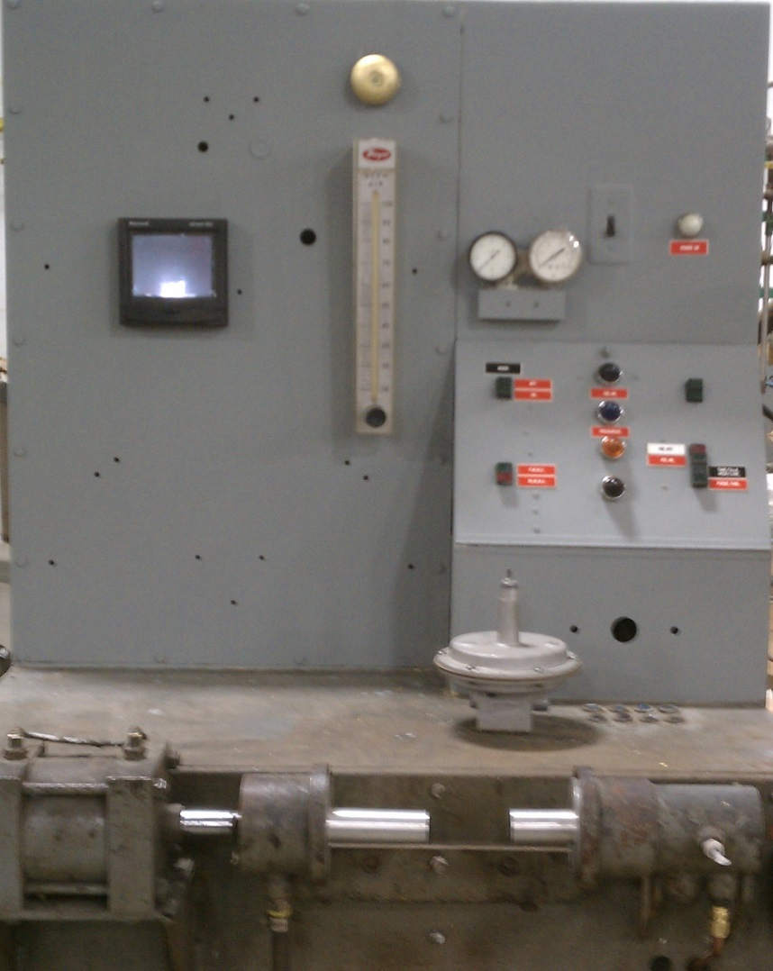
4BZR Test Rig
Objective: To test Balanced Zero Regulators performance against quality standards. The ability to digitally record and display test data.

Slide 12
4BZR Marketing Claim Tests

Slide 13

Thank you!

Slide 14

Questions?

